Slide 1
Travel PLANER agent
INTERNSHIP PROJECT
Presented By
Student name : SIBANGA KUMAR SAHU
College Name : INDIRA GANDHI INSTITUTE OF TECHNOLOGY, SARANG
Internship ID : INTERNSHIP_1748937226683eaa0a58abc

Slide 2
OUTLINE
Problem Statement
Technology used
Wow factor
Proposed Solution
End users
Result
Conclusion
Future scope
IBM Certifications
Git-hub Link

Slide 3
Problem Statement
Planning a trip involves multiple complex tasks—researching destinations, checking weather conditions, finding transport and accommodation, creating a suitable itinerary, and handling last-minute changes. These processes are often time-consuming, fragmented across multiple apps or websites, and stressful for users, especially when dealing with budget and time constraints.
The solution will utilize IBM Cloud Lite services and IBM Granite Foundation Models, integrating real-time data, maps, and local guides into a smart, user-friendly assistant that transforms how users plan and experience travel.

Slide 4
Technology used
IBM Cloud Lite Services
IBM Granite Foundation Models (for GenAI tasks)
IBM Watson Assistant
IBM Cloudant (for data storage)
IBM Weather API
IBM Maps Integration (or Google Maps via API if permitted)
Natural Language Processing(NLP)
IBM Cloud Agent Lab

Slide 5
Wow factors
This project stands out with its AI-powered personalized itinerary generation using IBM Granite, tailored to each user's budget, interests, and travel style. It offers real-time weather-based plan adjustments and smart alerts for delays or changes. The interactive chat interface makes planning feel like talking to a real travel agent. Integrated maps and booking suggestions provide a seamless, all-in-one travel experience.

Slide 6
Proposed solution
User Registration & Input Collection
User logs in and interacts with a chatbot interface (IBM Watson Assistant).
The system collects preferences: destination, budget, travel dates, interests and constraints.
2. Data Processing & Preference Analysis
Inputs are processed using IBM Granite for natural language understanding.
User profile is created based on travel behavior, priorities, and available time.
3. Transport & Accommodation Recommendations
Recommends real-time flight/train and hotel options through integration with travel APIs.
Options are filtered based on budget, convenience, and availability.
4. Integration with Real-Time Services
Integrates weather updates via IBM Weather API to adjust plans accordingly.
Uses maps and local guides to enhance the travel experience.

Slide 7
End users
Individual Travelers looking for personalized and hassle-free trip planning
Families and groups planning vacations with multiple preferences
Students and budget-conscious users needing affordable and optimized travel plans
Corporate professionals managing business travel efficiently
Industry R&D Teams makes plan according to travel circumstances
Travel agencies seeking AI tools to enhance customer service

Slide 8
Algorithm & Deployment
User Input Collection via chatbot using IBM Watson Assistant
NLP-based Preference Extraction using IBM Granite (e.g., budget, location, interests)
Itinerary Generation using rule-based and AI-driven suggestions
Scoring & Matching Algorithm filters best destinations, stays, and transport options
Real-Time Monitoring of weather and travel APIs for changes
Dynamic Replanning triggered by alerts (delay, cancellation, weather)
AI Services:
IBM Watson Assistant (chat interface)
IBM Granite (itinerary generation & NLP)
Database: IBM Cloudant for storing user profiles and plans
Real-Time Alerts: IBM Event Streams (Kafka) for updates
APIs Used: Weather API, Maps API, Travel Booking APIs
Deployment Platform: IBM Cloud Lite(fully cloud-hosted and scalable)

Slide 9
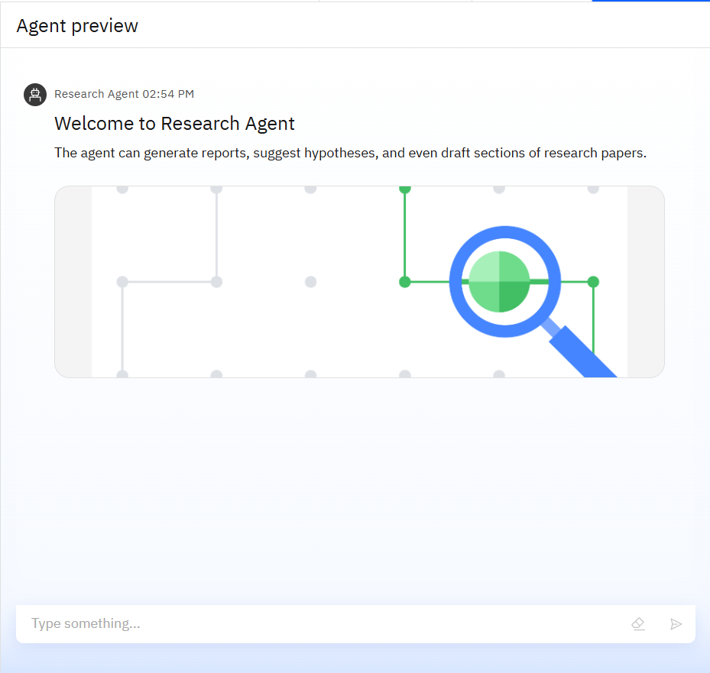
Results

Slide 10
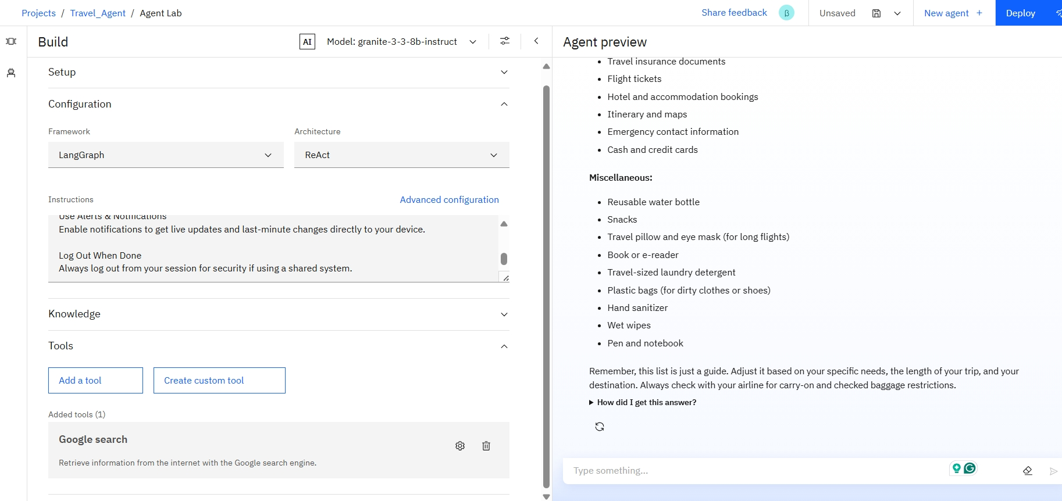
screenshots

Slide 11
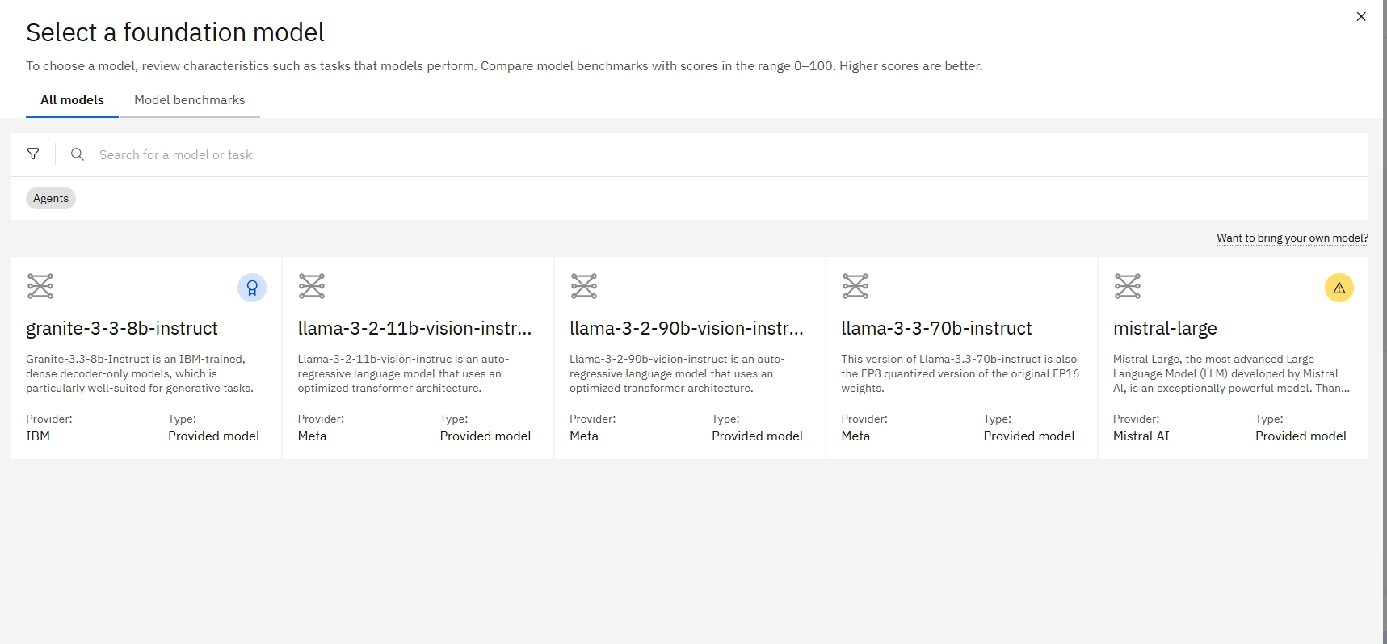
Results

Slide 12
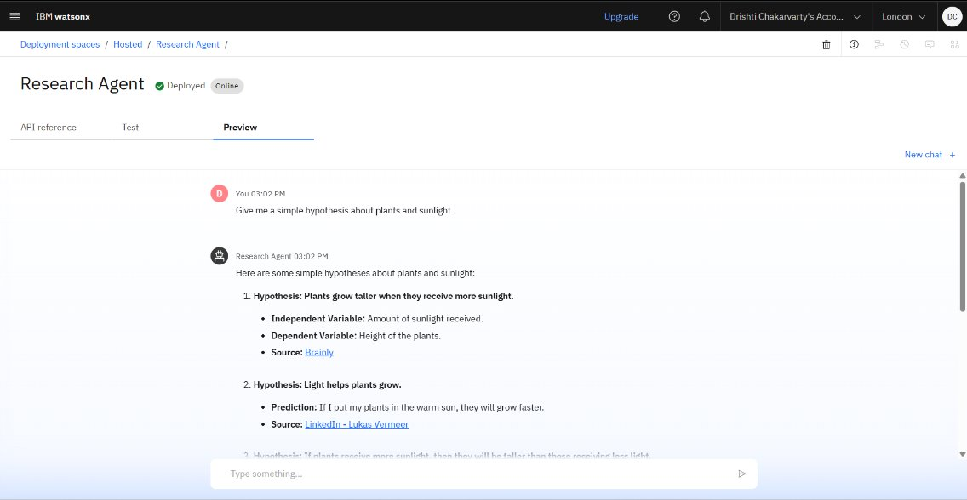
Results
Deployed AI Agent

Slide 13
Conclusion
The Travel Planner Agent successfully simplifies and personalizes the travel planning process using AI and real-time data. By leveraging IBM Cloud Lite and Granite models, the system offers intelligent itinerary generation, smart recommendations, and dynamic adjustments. Users benefit from a seamless, all-in-one platform that saves time, reduces effort, and enhances their travel experience. The integration of conversational AI, weather updates, and live alerts makes it a practical and innovative solution for modern travelers. This project demonstrates how AI can transform complex planning into a smooth, enjoyable journey.

Slide 14
Future scope
Voice Assistant Integration (e.g., Alexa, Google Assistant) for hands-free trip planning
Multi-language Support to cater to users from different regions and countries
Live Booking Integration with airlines, hotels, and transport platforms
Group Travel Planning feature to coordinate plans among friends or families
Integration with AR/VR for virtual previews of destinations and activities
AI-based Budget Optimizer to auto-suggest best-value travel options within limits

Slide 15
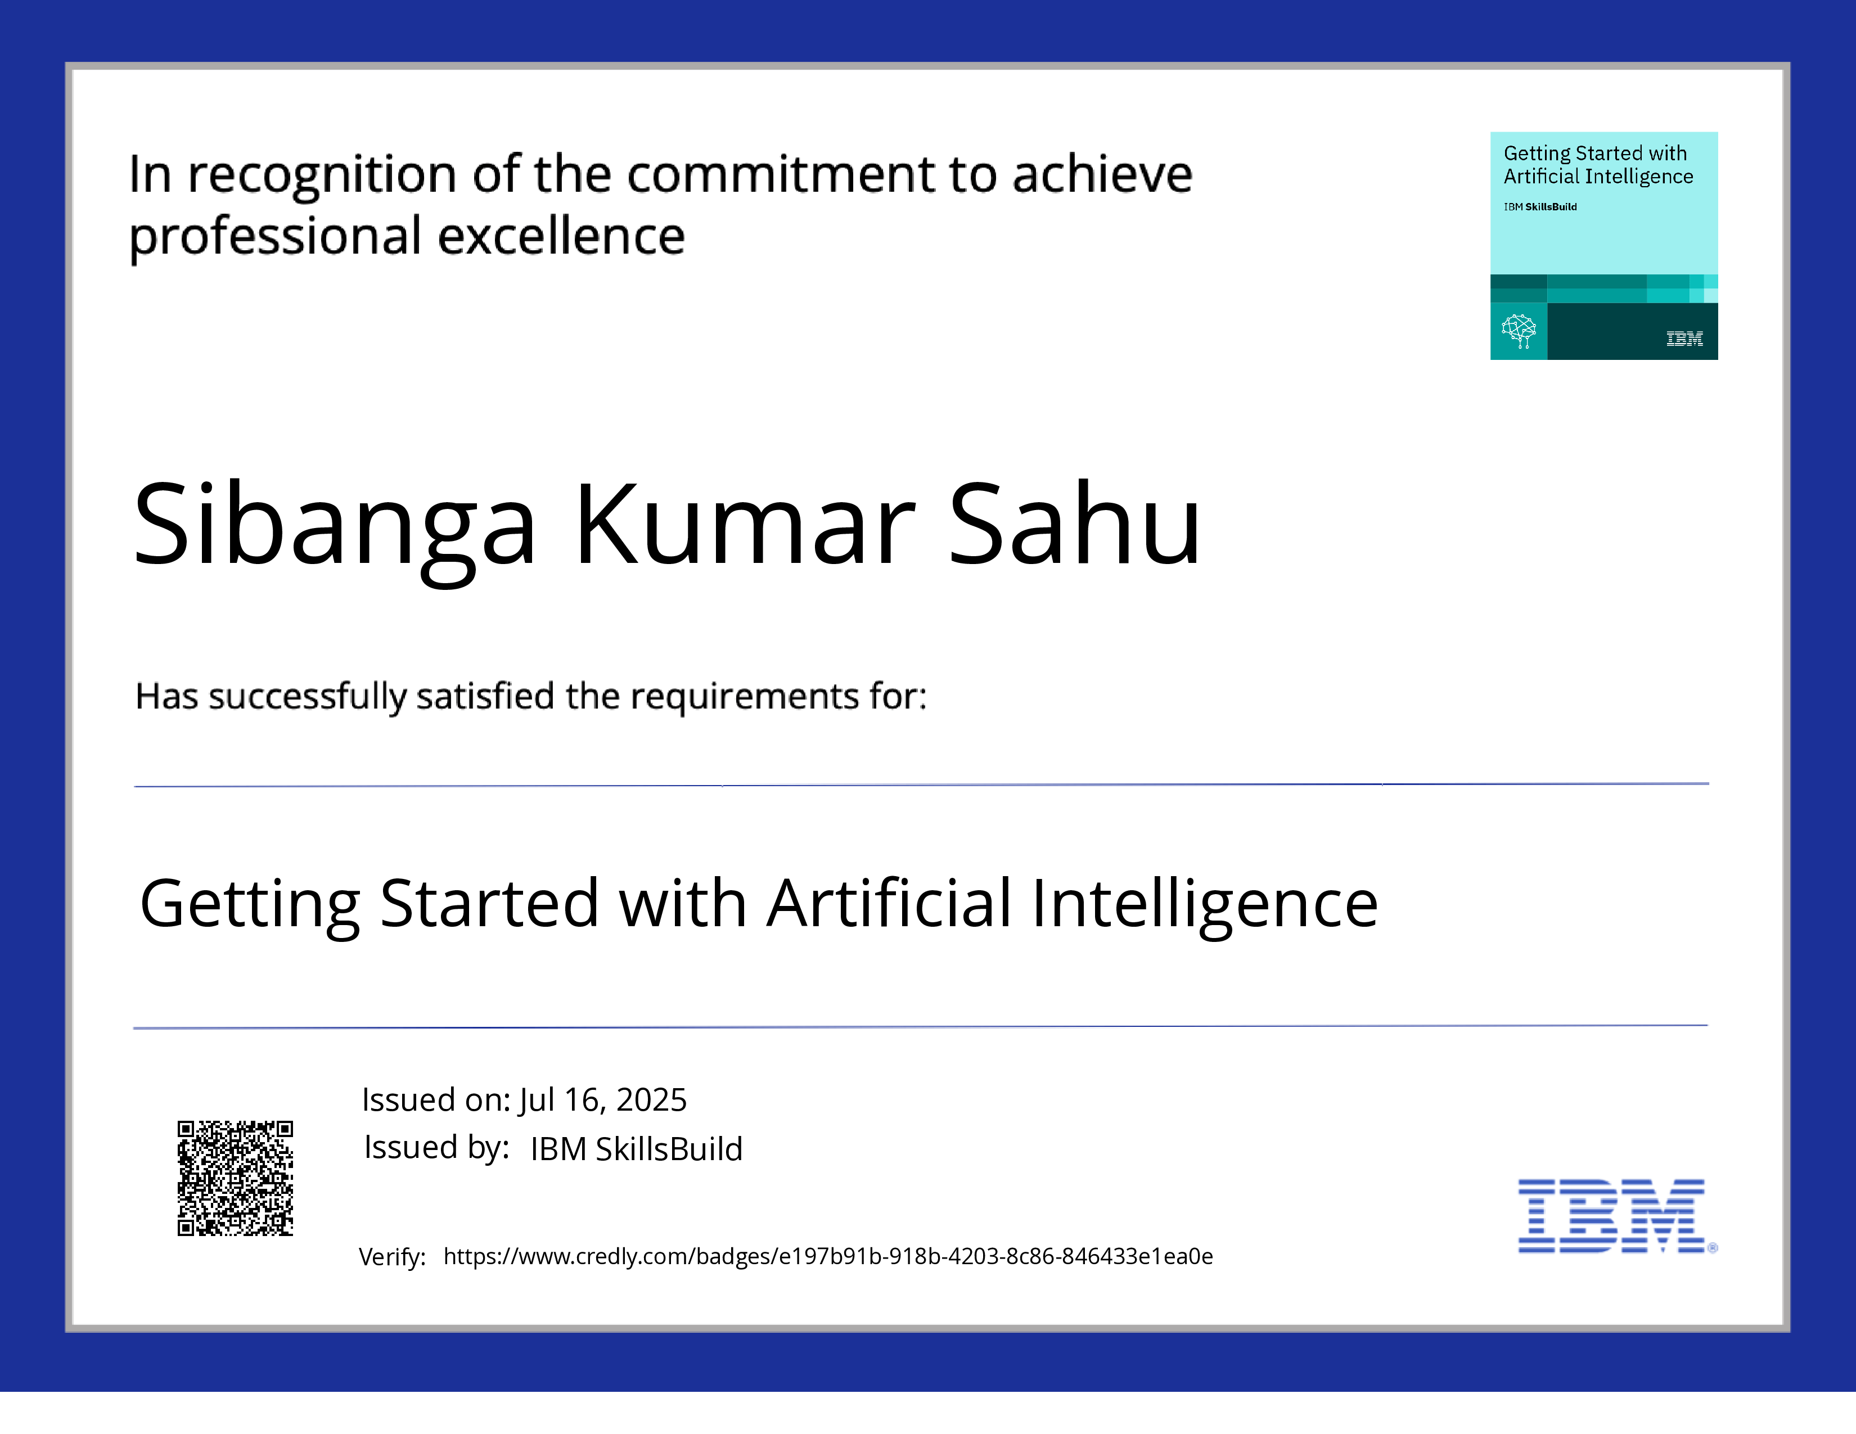
IBM Certifications

Slide 16
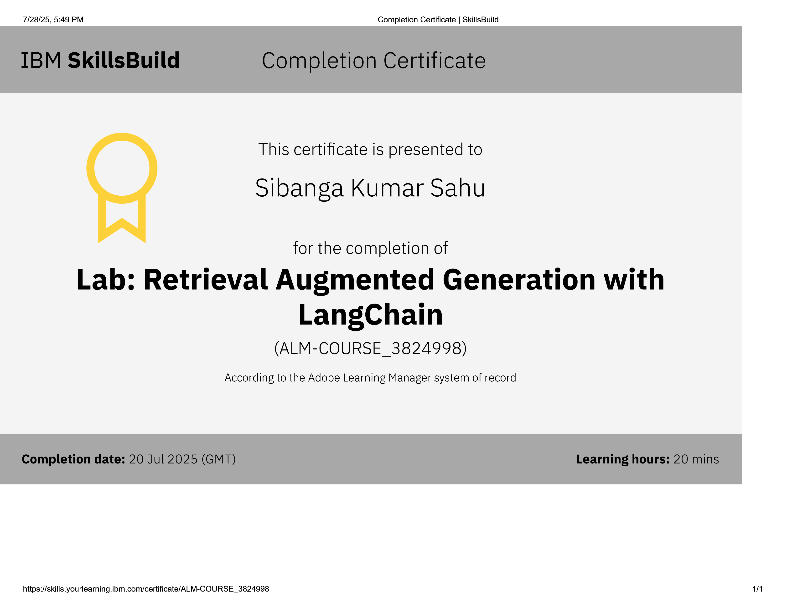
RAG LAB CERTIFICATE

Slide 17
GitHub Link
GitHub link:- https://github.com/sibanga/AICTE_Internship_Week1.git

Slide 18
THANK YOU

